Slide 1

Restore Home Health
Face to face training
March 2021

Slide 2

F2F Overview
Mandated by the Affordable Care Act (2010)
Required for SOC home health certifications on or after Jan. 1, 2011
F2F is condition of payment, NOT a condition of participation
Agency can be denied payment even if all other conditions are met
The F2F requirement ensures that the orders and certification for home health services are based on a physician’s current knowledge of the patient’s clinical condition

Slide 3
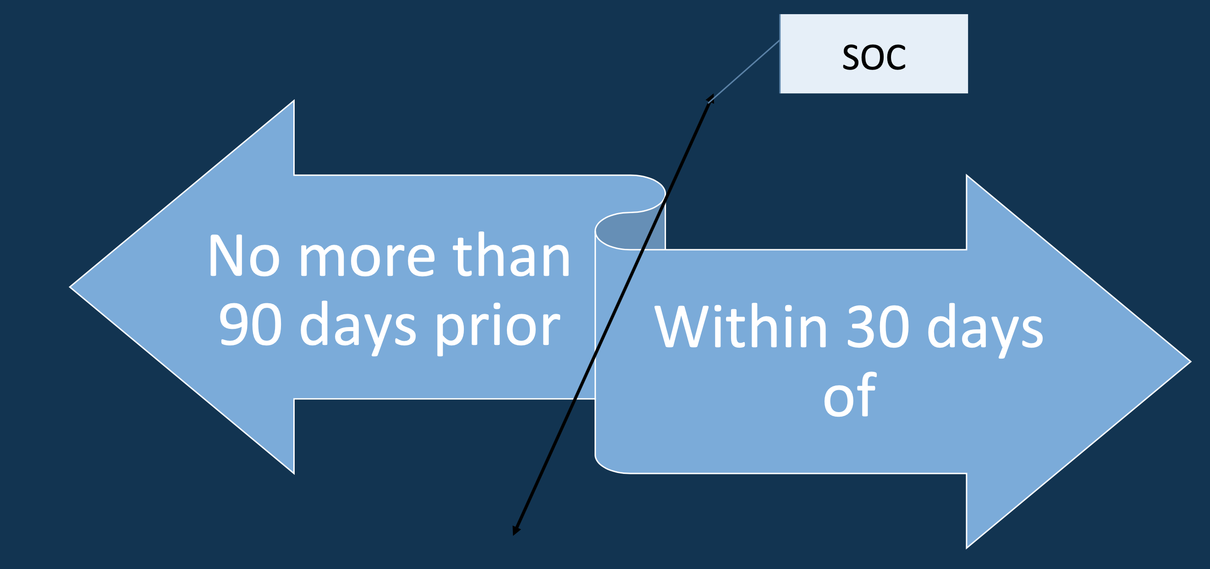
When Should a Face to Face Occur?

Slide 4
Certifying For Home Health
Certifying physician must certify that Medicare HH eligibility has been met to include the following:
Be confined to the home
Under the care of a physician
Services are provided under a plan of care established and periodically reviewed by a physician
Be in need of skilled nursing care on an intermittent basis or physical therapy or speech-language pathology; or have a continuing need for occupational therapy
Have a documented F2F encounter with physician or allowed non-physician practitioner (NPP)

Slide 5

Required Components of the Face to Face
Documentation of the name of the MD or NPP who saw the patient and the date of the encounter
Clinical condition that supports homebound status
Need for skilled services
Supports primary reason the patient required home health
Reason for home health referral
MD name, signature and date
Additional items may be located throughout the medical record, but must be clearly identifiable
Did we check off all the items?

Slide 6
Examples of Appropriate Documents
Discharge summary
MD office visit note
Progress note from acute/post-acute facility
Note on MD letterhead summarizing the required information
Clinical summary
Admission summary
History & Physical

Slide 7
Examples of Inappropriate Documents
Diagnosis list alone
Recent procedures alone
Recent injuries alone
Generic statement without specific clinical finding to indicate what makes the patient homebound:
  “taxing effort to leave home”
  “gait abnormality”
  “weakness/muscle weakness”

Slide 8
Who Can Complete the Face to Face
Certifying physician
Physician who cared for patient in acute/post-acute facility
Nurse practitioner
Clinical Nurse Specialist
Certified Nurse-midwife
Physician Assistant

Slide 9
Top Reasons For Denial
Actual F2F visit date doesn’t match the date on the F2F form or attestation statement
Referral diagnosis doesn’t match primary reason for home health care
Documentation does not support homebound status or need for skilled service

Slide 10
Homebound Certification Statement
Must be added to all SOC’s and match encounter date with physician (either from acute care facility documentation or clinical note from office visit). Date and signature required on all encounters.
“I certify that this patient is confined to his/her home and needs intermittent skilled nursing care, physical therapy and/or speech therapy or continues to need occupational therapy. The patient is under my care, and I have authorized services on this plan of care and will periodically review the plan. The patient had a face-to-face encounter with an allowed provider type on -00/00/0000 and the encounter was related to the primary reason for home health care.

Slide 11
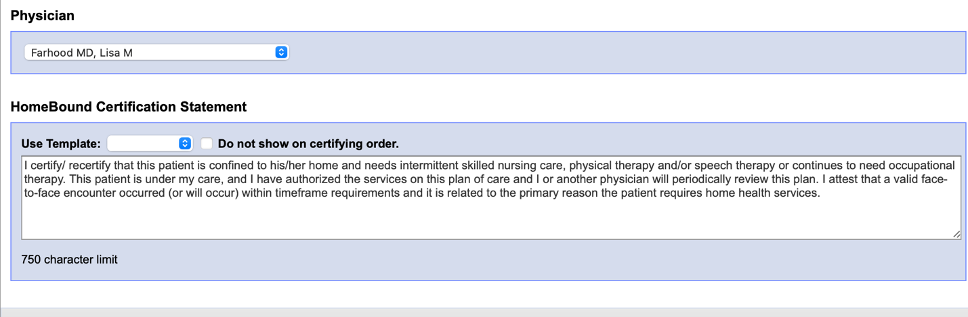
Where Do I Put the Statement?

Slide 12

What Does the Statement Cover?
Under Care of a physician
Confinement to home
Need for skilled services
Have a documented F2F encounter with physician or allowed non-physician practitioner (NPP)
Services are being provided under a plan of care established and periodically reviewed by the physician
Primary reason for home health
Reason for home health services

Slide 13
The Statement Does Not Cover
Documentation of the name of the MD or NPP who saw the patient and the date of the encounter or the supporting reasons for home health (This information must be connected to the encounter date and the documentation provided by the acute care facility and/or the doctor’s office. If not present – a face to face documentation form must be sent.

Slide 14
Additional Information
If the F2F encounter occurs within 90 days of SOC BUT is not related to the primary reason for home health, there must be another F2F encounter within 30 days after the SOC

Slide 15
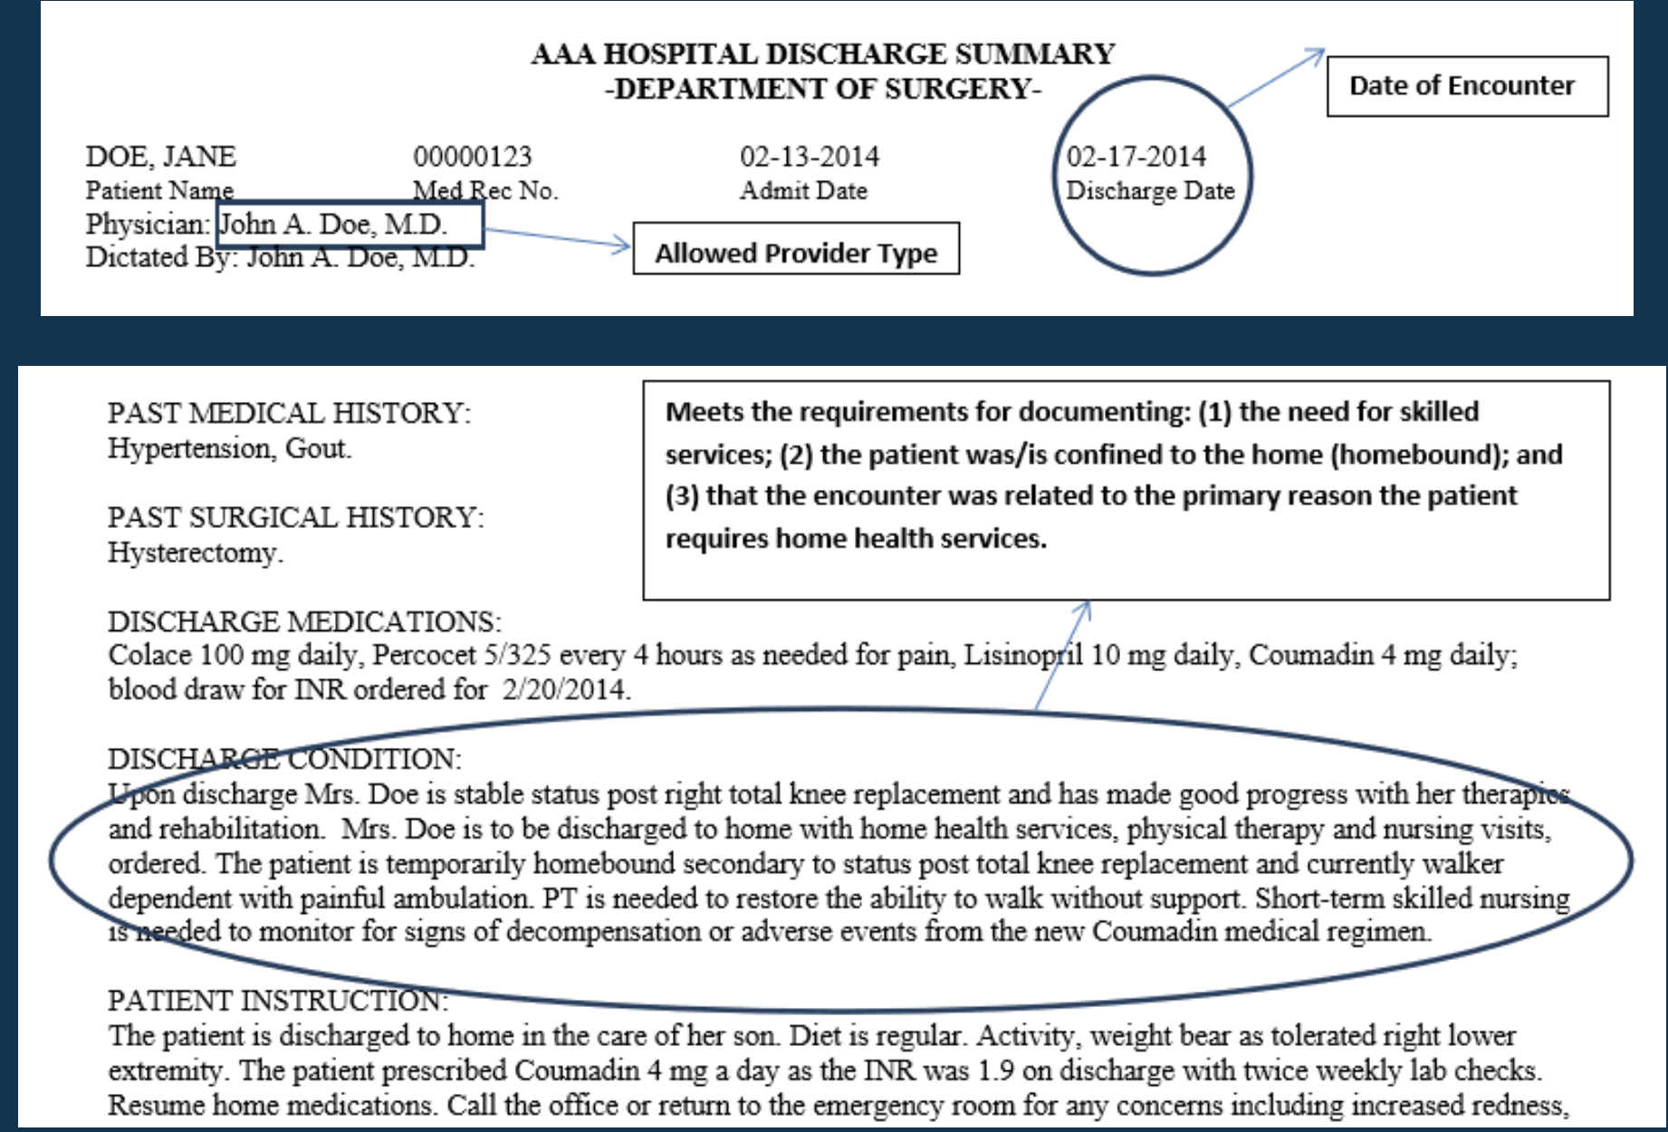
Examples

Slide 16
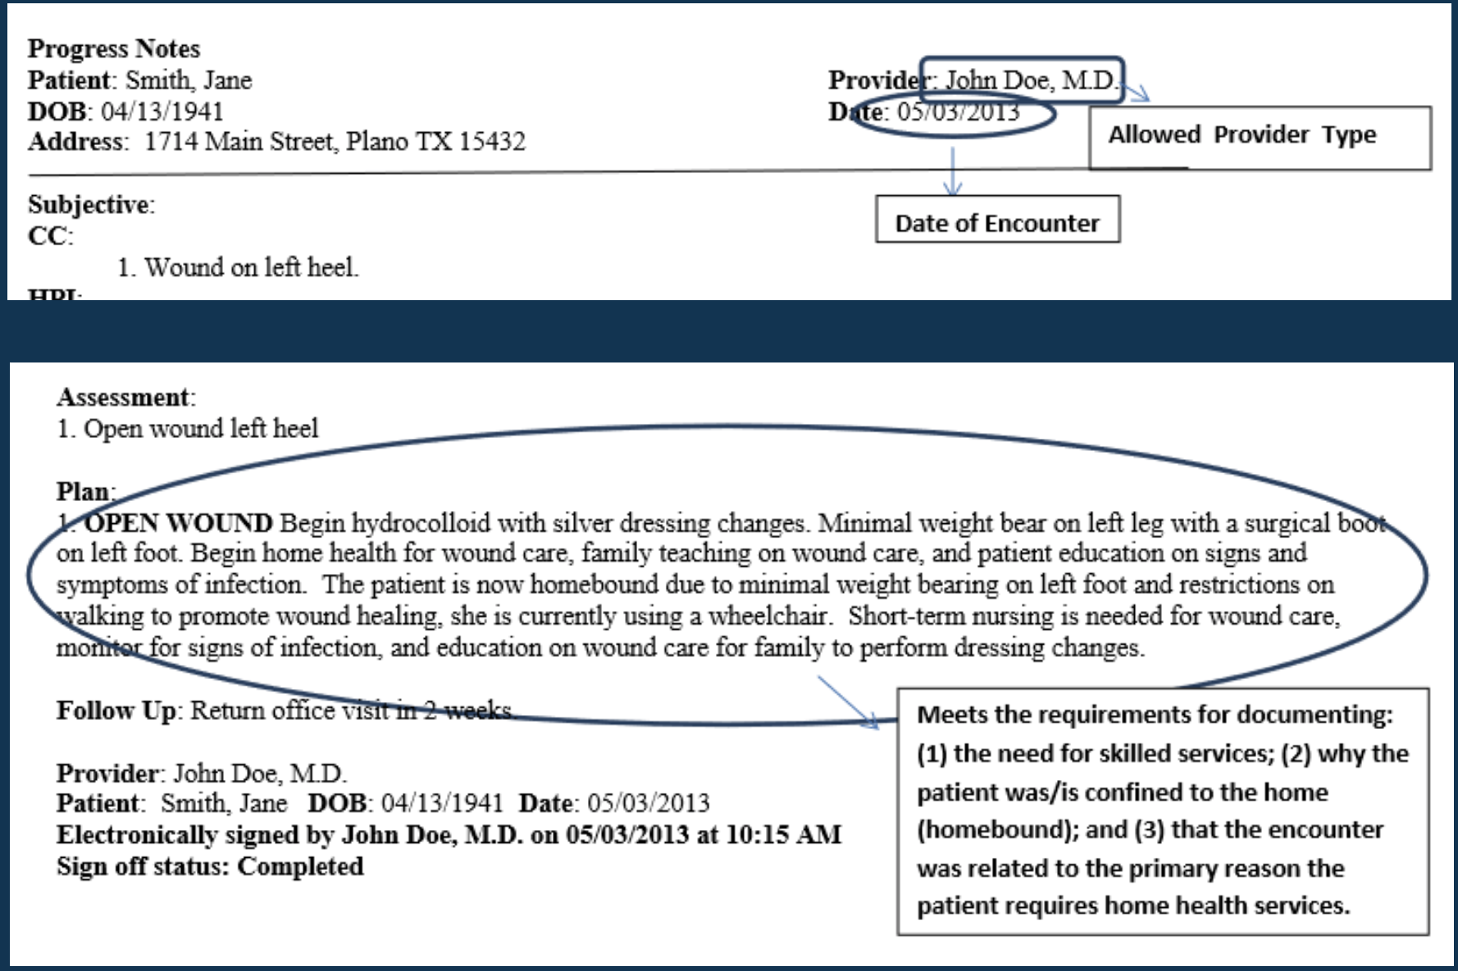
Examples

Slide 17
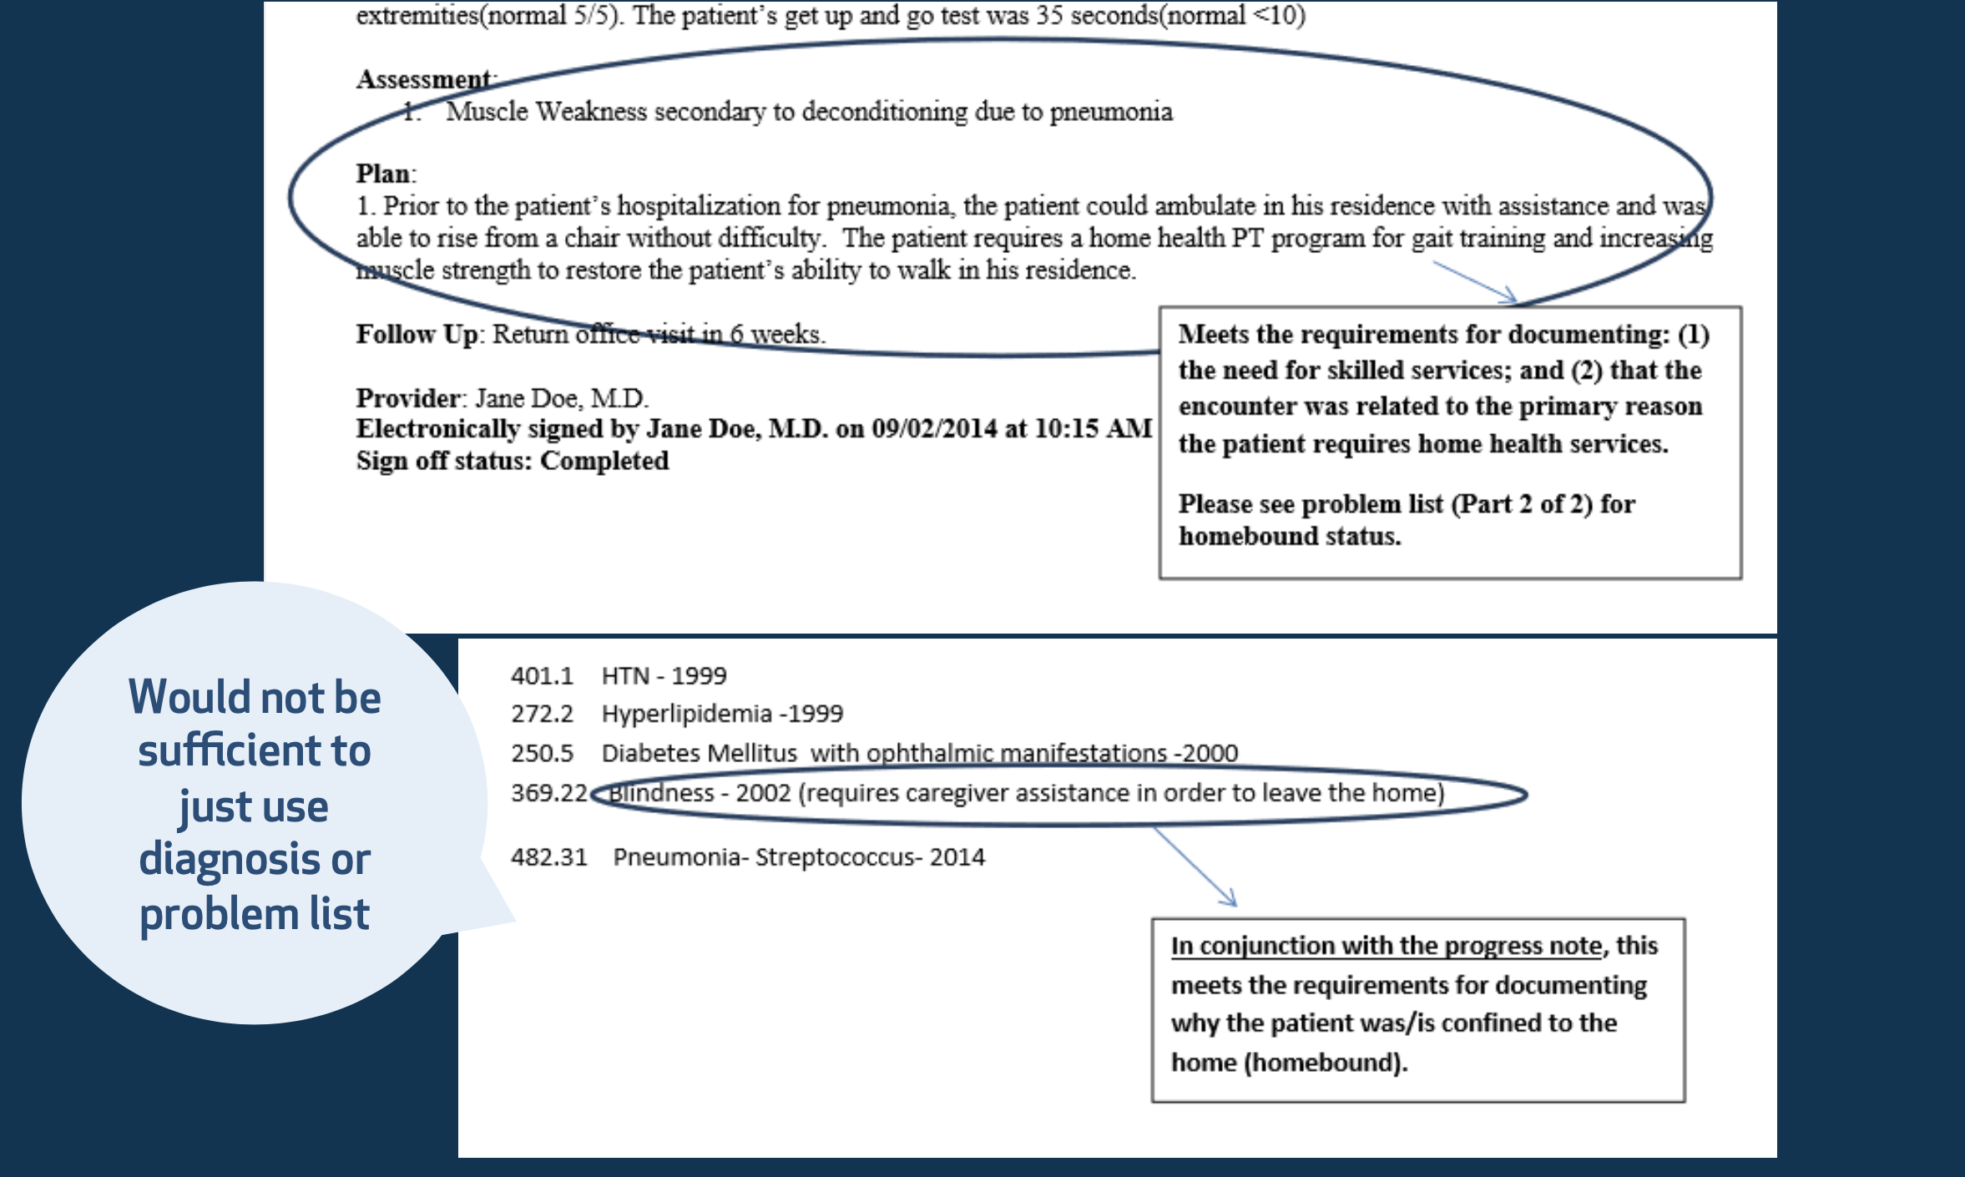
Examples

Slide 18
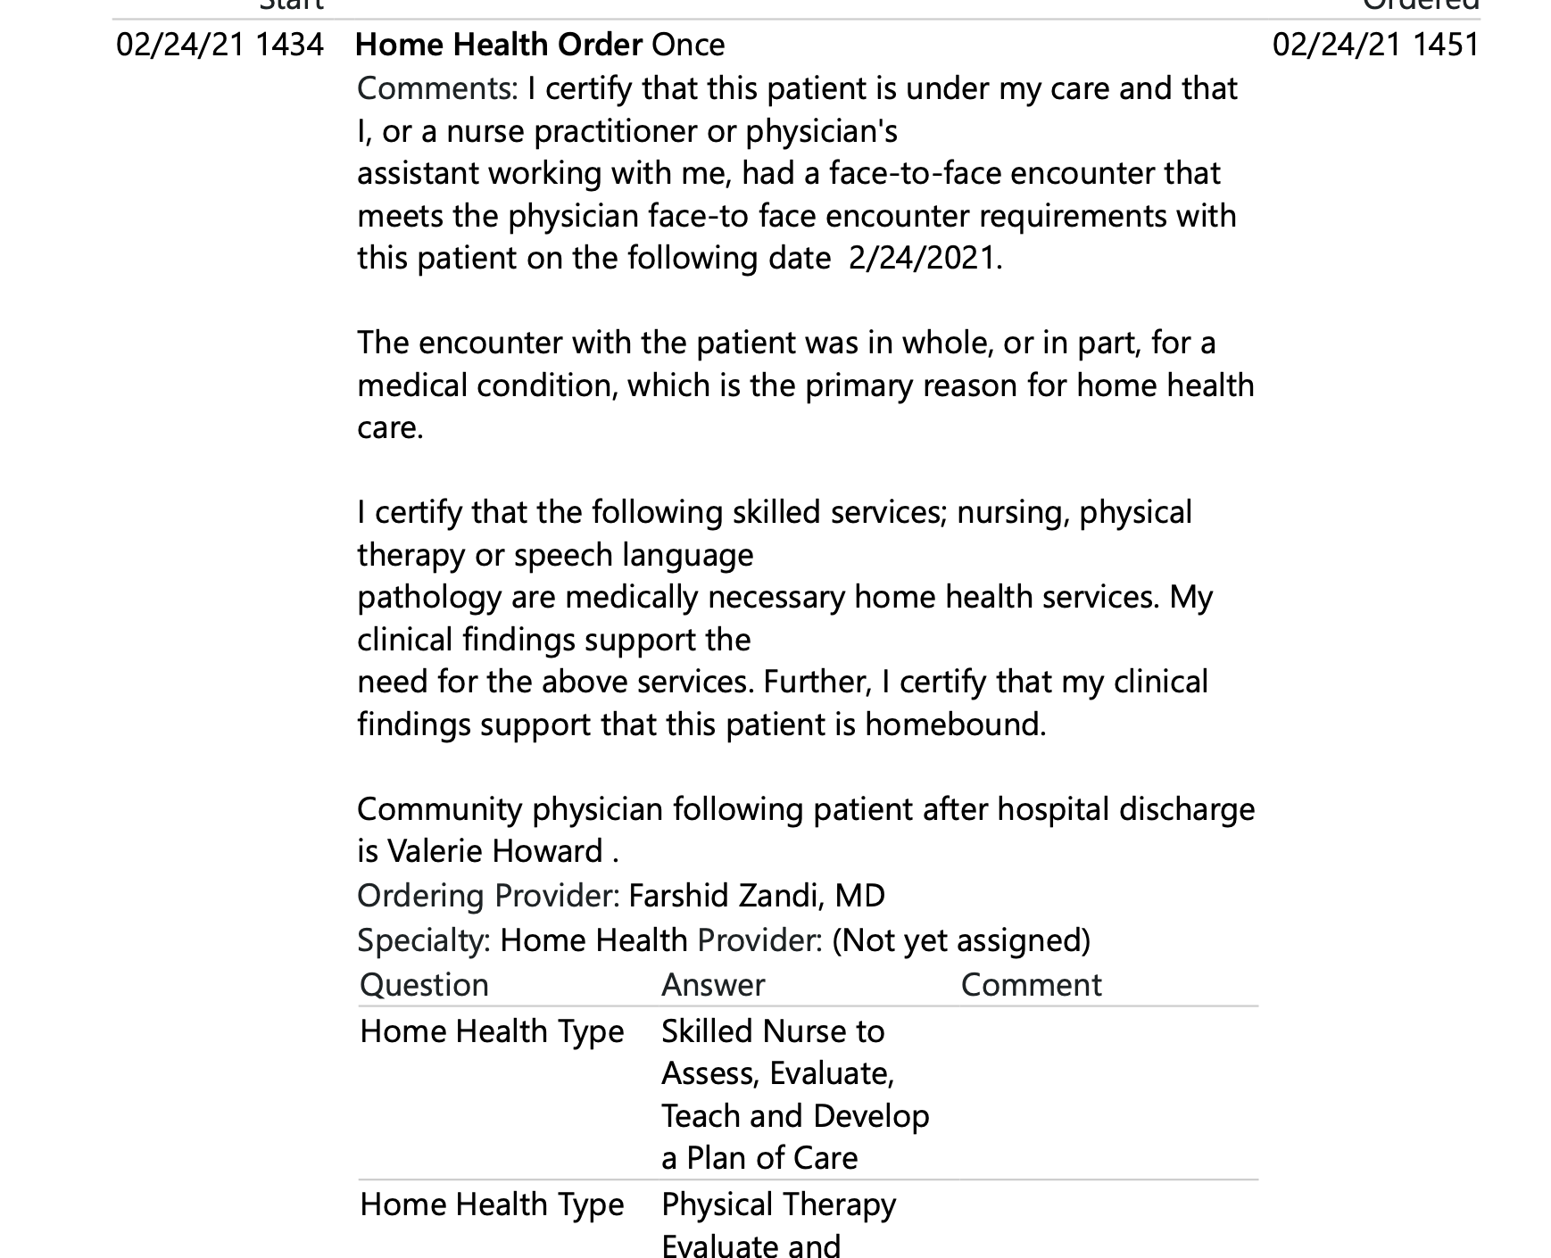
Examples

Slide 19
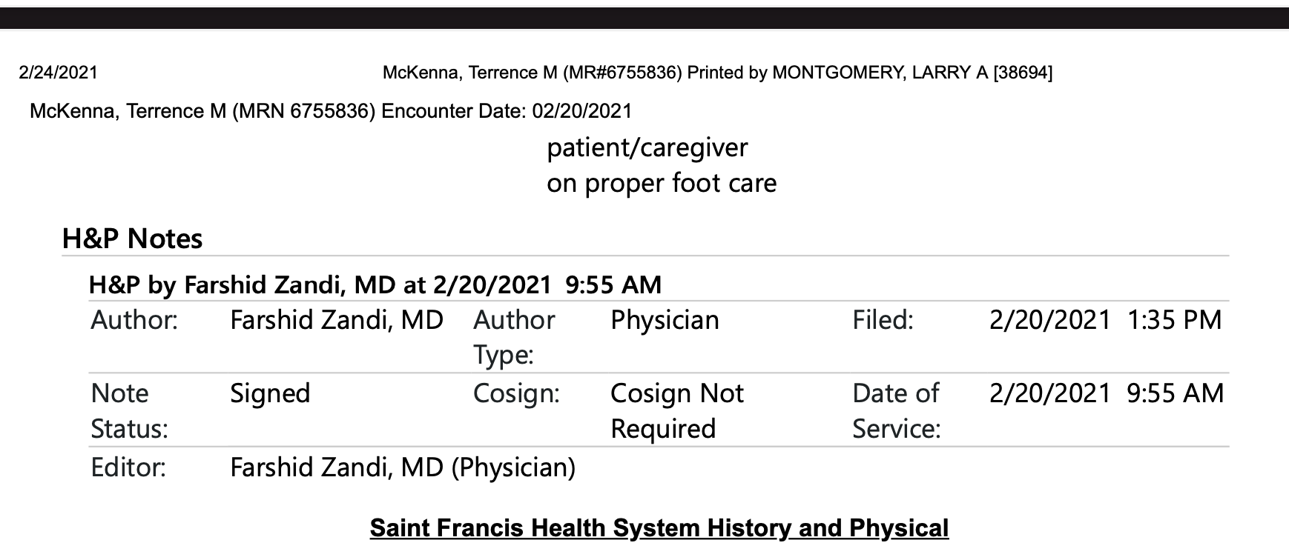
Examples

Slide 20
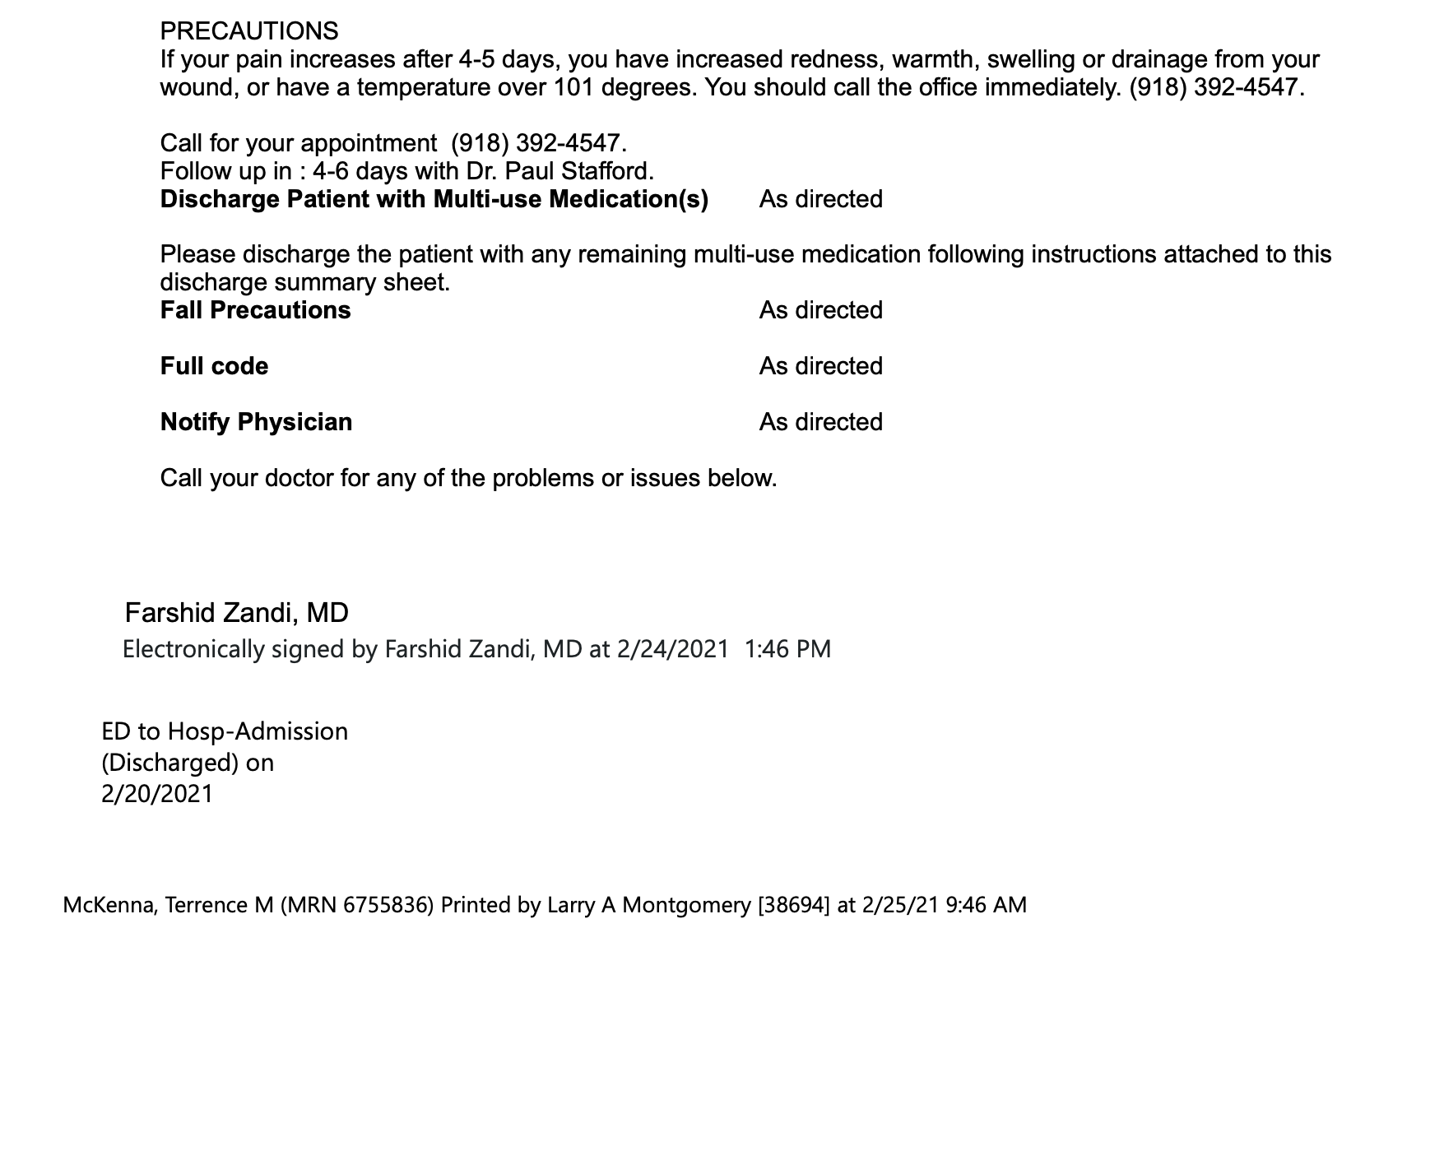
Examples

Slide 21
Strategies
Contact the MD for an attestation statement to update the F2F information if documentation does not match primary reason for home care
Example: MD F2F states muscle weakness, recurrent falls. Comprehensive assessment reveals patient has Parkinson’s disease and neuropathy.
Notify MD of need for additional services that may not be included on the F2F and generate a verbal order updating the primary reason for home care
Example: PT only ordered at SOC but found the have unstable blood sugars with multiple new meds

Slide 22
Strategies (Cont.)
Make sure dates on F2F are congruent with actual visit note date • If dates do not match, claim can be denied
Start with an effective referral
Order for HH services
Verify who will be the certifying physician
Documentation supporting the need for skilled service and homebound status
F2F encounter documentation
Have a process in place to monitor for pending F2F visits
Also have a policy to assess for scheduled F2F visits and have agency assist patient/CG with making appointments if not scheduled

Slide 23
Strategies Cont.
When Veronica calls to confirm physician, ask when they last time they were seen - if it is within the 90 days prior to admission – request progress notes from that encounter.
All RN’s are required to confirm the date of the follow-up appointment at SOC. This needs to be dated in the clinical record. If the patient does not have a follow-up appointment, please assist with scheduling this.
Once the follow-up visit is confirmed – on the skilled nursing note proceeding the visit – a notation must be made on the details indicating that date – the nurse or supervisor should call and request the clinical record.

